Slide 1
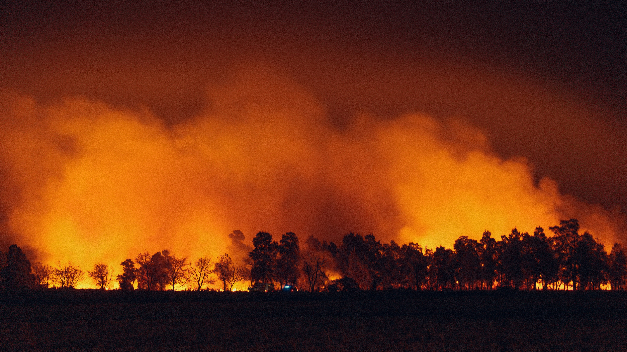


Analysis of Extreme Weather and Climate Events Impacts on Key Community Health and Economic Attributes
WORKING DRAFT
2024 AI BOOTCAMP | MODULE 10 GROUP PROJECT
Contributors: Jamie Bond, Mike Szumski, Rajesh Velamala

Slide 2
NOTE: Page numbers to be updated
CONTENTS |  | PAGE
Executive Summary |  | 3
Data Exploration |  | 5
Project Approach |  | 7
Additional Questions |  | 6
Results and Conclusion |  | 8
Reference Content |  | 10
PROJECT OBJECTIVE
In this project, the University of North Carolina Charlotte / Chapel Hill AI Bootcamp project team conducted a data analysis to examine the impacts of extreme weather and climate events on public health and local economy, with a particular emphasis on extreme heat and impacts to North Carolina.

Slide 3
Executive Summary
An executive summary or overview of the project and project goals (5 points)
DATA TRANSFORMATION AND ANALYSIS
Using Python tools and libraries, the investigating team conducted the following key activities:
Data Identification and Exploration – identified and reviewed available datasets, screening for data applicability and data quality
Data Transformation – imported, cleaned and joined datasets by location and date attributes or disaster ID
Data Analysis – explored the relationship of the various datasets using
pandas to investigation data correlation and dimensionality
numpy and pandas to analyze [XXX ]
scipy to perform [statistical analysis]
phophet to explore [time series forecasts]
KEY FINDINGS
After examining XXX, data analysis revealed XXX ..
PROJECT OBJECTIVE
To examine the impacts of extreme weather and climate events on public health and local economy, with a particular emphasis on extreme heat and impacts to North Carolina
DATA SOURCES
The investigating team narrowed its efforts on the collection, transformation, analysis and visualization of daily, county-level data (where available) for the five-year period between 2018 - 2022, focusing on the relationship between extreme events and the following:
FEMA Data: Nationally declared disasters by time period and location
US SBA Data: Disaster Loan Program assistance issued by location and disaster
CDC Data: Hospitalization and mortalities by time period and location

Slide 4
Executive Summary – con’t
An executive summary or overview of the project and project goals (5 points)
DataViz Placeholder
DataViz Placeholder
DataViz Placeholder
DataViz Placeholder
CONCLUSION
The data suggest …

Slide 5
Data Exploration
An overview of the data collection, cleanup, and exploration processes (5 points)
Notes:
DATA SOURCES
The investigating team narrowed its efforts on the collection, transformation, analysis and visualization of daily, county-level data (where available) for the five-year period between 2018 - 2022, focusing on the relationship between extreme events and the following:
FEMA Data: Nationally declared disasters by time period and location
US SBA Data: Disaster Loan Program assistance issued by location and disaster
CDC Data: Hospitalization and mortalities by time period and location

Slide 6
Project Approach
The approach that your group took in achieving the project goals (5 points)
Notes:
DATA TRANSFORMATION AND ANALYSIS
Using Python tools and libraries, the investigating team conducted the following key activities:
Data Identification and Exploration – identified and reviewed available datasets, screening for data applicability and data quality
Data Transformation – imported, cleaned and joined datasets by location and date attributes or disaster ID
Data Analysis – explored the relationship of the various datasets using
pandas to investigation data correlation and dimensionality
numpy and pandas to analyze [XXX ]
scipy to perform [statistical analysis]
phophet to explore [time series forecasts]

Slide 7
Additional Questions
Any additional questions that surfaced, what your group might research next if more time was available, or share a plan for future development (5 points)

Slide 8
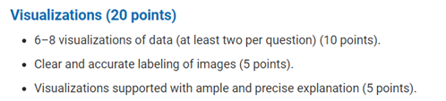
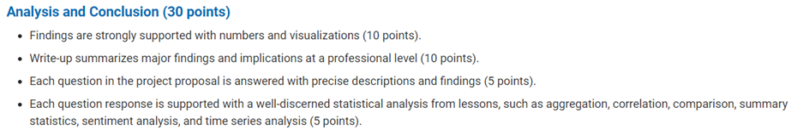
Results and Conclusion
The results and conclusions of the application or analysis (5 points)

Slide 9
Results and Conclusion, Con’t
The results and conclusions of the application or analysis (5 points)

Slide 10
Reference Content
GitHub
Project Repository: github.com/mikeszumski/Project_One_Repo
Contributors
Jamie Bond | @JBondAI
Michael Szumski | @mikeszumski
Rajesh Velamala | @REJESHVELAMALA
Data Providers
Federal Emergency Management Agency (FEMA)
US Small Business Administration
Center for Disease Control
North Carolina Department of Public Safety
Notes:
Disaster Information Dataset ( API Integration) - 2018 - 2022 https://www.fema.gov/data-visualization/disaster-declarations-states-and-counties - Rajesh API Documentation # https://www.fema.gov/about/openfema/api
Disaster Declaration Dataset https://lending.sba.gov/search-disaster/ - Jamie
Disaster Loan Data - Jamie https://data.sba.gov/dataset/e243640a-ed1c-4941-850e-b2c6aa15cad3/resource/dfca7ddd[…]a1-bb89-98fae0e6ff3a/download/sba_disaster_loan_data_fy22.xlsx
NC Disaster https://www.ncdps.gov/emergency-management/past-disasters
CDC- Mike https://data.cdc.gov https://wonder.cdc.gov/nndss/nndss_weekly_tables_menu.asp

